Slide 1




PROJECT: CONTINOUS IMPROVEMENT AND LEAN MANUFACTURING
Submitted by:
AKSHAY K
TTC0822011

Slide 2

CONTENTS
The project outline .
Stakeholders involvement etc.
The potential activities/priorities
How the project can meet the needs
The Time frames & milestones
Conflicts and mitigations
What success will look like.

Slide 3
The outline of this project is :
To be named as best in sector
To achieve a safe working environment
To increase Customer satisfaction from 88.2%, (current) to 95%
To increase Job security for the workforce
To increase employee Job satisfaction from 63%, (current) to 90%
To increase employee retention by 5%
To decrease employee sickness levels from 4.1% to 2%

Slide 4

The stakeholders involved in this project are:
Bob Ashville
MD
Commercial Director
Operation Director
Site Manager
HR Director
Finance Director
Consultancy Team
Employee
Customer

Slide 5

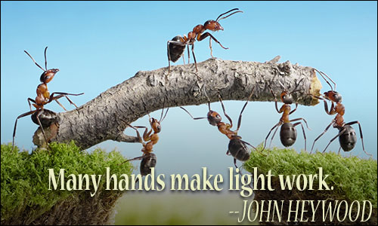
The activities that are planned to complete this project:
1. Form team
2. Develop communication and feedback channel for everyone
3. Meet with everyone and explain the initiative
4. Begin to train all employees
5. 5s
6. TPM
7. Value stream mapping
8. Waste identification
9. Process mapping

Slide 6


The estimated time for each of the tasks/priorities
Form team - 1 week
Develop communication and feedback channel for everyone – 1 week
Meet with everyone and explain the initiative - 1 week
Begin to train all employees (lean overview, eight wastes, standard operations, kaizen, RCPS, PDCA - 6 months
Facility analysis - 3 weeks
5S - 3 weeks
TPM - 6 months
Value stream mapping - 2 months
Waste identification - 3 weeks
Process mapping - 2 weeks
Takt time - 2 months
Implement Kaizen - 6 months

Slide 7


The risks that can be faced while executing the project:
Lack of strategic focus
The time factor
The human factor
Transportation
Inventory
What could be the mitigations for those:
Gemba
Hoshin kanri
Jidoka
Kaizen
Poka-yoke

Slide 8

At the end of the project the company will be able to achieve its goal that is:
Safe work environment
Make the sector more than better.
Become number one producers

Slide 9



